Slide 1


Slide 2

Machine Learning
Session 3

Slide 3
Agenda:
1 | Logistic regression
2 | Classifcation metrics

Slide 4

Logistic regression

Slide 5
Logistic regression
Logistic Regression is a supervised learning classification algorithm used to predict the probability of a categorical target variable. It deals with discrete classes like Yes or No, 0 or 1, True or False.
Probabilistic Output
Unlike linear regression, logistic regression outputs a probability value between 0 and 1, indicating the likelihood that a given input belongs to a certain class. Based on a threshold (usually 0.5), logistic regression then classifies the input as either class 0 or class 1.

Slide 6
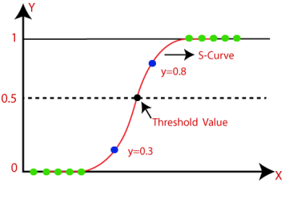
Logistic regression
S-Curve
Instead of fitting a straight line (as in linear regression), logistic regression fits an S-shaped logistic curve. This sigmoid curve maps the outputs to probabilities between 0 and 1.

Slide 7

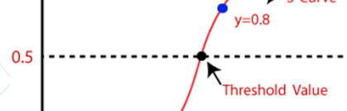
Logistic regression
Logistic Function
1. Logistic (Sigmoid) Function
The logistic function, also known as the sigmoid function, is a mathematical function that maps the predicted values to probabilities. The formula is:
This function produces values between 0 and 1, making it ideal for classification problems. The curve's shape indicates the decision boundary for classification.

Slide 8
Logistic regression
Logistic Regression Equation
1. Hypothesis for Linear Regression
The hypothesis of linear regression is given by
Here, 𝑥 represents the input features, and 𝜃 represents the coefficients or weights learned by the model.

Slide 9
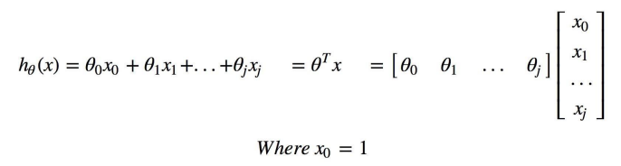
Logistic regression
Logistic Regression Equation
2. Extension for Logistic Regression
Logistic regression uses the same linear hypothesis but transforms the output using the sigmoid function to convert the values into probabilities.

Slide 10

Logistic regression
Logistic Regression Equation with Sigmoid Function
1. Logistic Hypothesis
The hypothesis for logistic regression is represented as :
Here, 𝜎 is the sigmoid function, which converts the linear equation's output into a probability.

Slide 11
Logistic regression
Logistic Regression Equation with Sigmoid Function
2. Probabilistic Interpretation
In this equation, 𝑦^ represents the predicted probability that the instance 𝑥 belongs to class 1. Based on this probability, logistic regression makes a decision about the class.

Slide 12
Logistic regression
Sigmoid Function Explanation
1. Application of Sigmoid Function
The sigmoid function is applied to the linear model's raw output to map it to a value between 0 and 1. This makes it possible to compare the predicted output with a threshold value (e.g., 0.5) and classify the input accordingly.

Slide 13
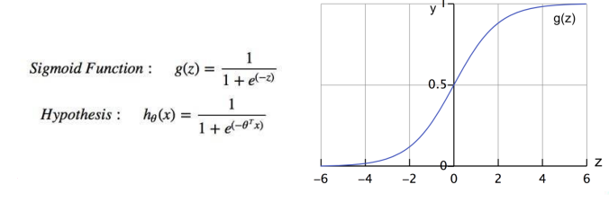
Logistic regression
Sigmoid Function Explanation
2. Graph of Sigmoid Function
The sigmoid function graph shows the curve with values transitioning from 0 to 1, with the steepest part of the curve near 0.5, indicating the threshold for classification.

Slide 14


Logistic regression
Logistic Regression Decision Boundary
1. Hypothesis for Class 1
The hypothesis function returns the probability that 𝑦=1, given 𝑥, parameterized by 𝜃. The formula is:
2. Decision Boundary

Slide 15
Classifcation metrics

Slide 16
Classifcation metrics
When working with classification problems, especially binary or multiclass classification, we need to evaluate how well our model is performing. For this, we use a set of metrics called classification metrics.

Slide 17
Classifcation metrics
1. Confusion Matrix
The confusion matrix is the foundation of most classification metrics. It is a 2x2 table (for binary classification) that shows the actual vs predicted values in four categories:
True Positives (TP): Correctly predicted positive classes.
True Negatives (TN): Correctly predicted negative classes.
False Positives (FP): Incorrectly predicted positive classes (also called Type I Error).
False Negatives (FN): Incorrectly predicted negative classes (also called Type II Error).

Slide 18
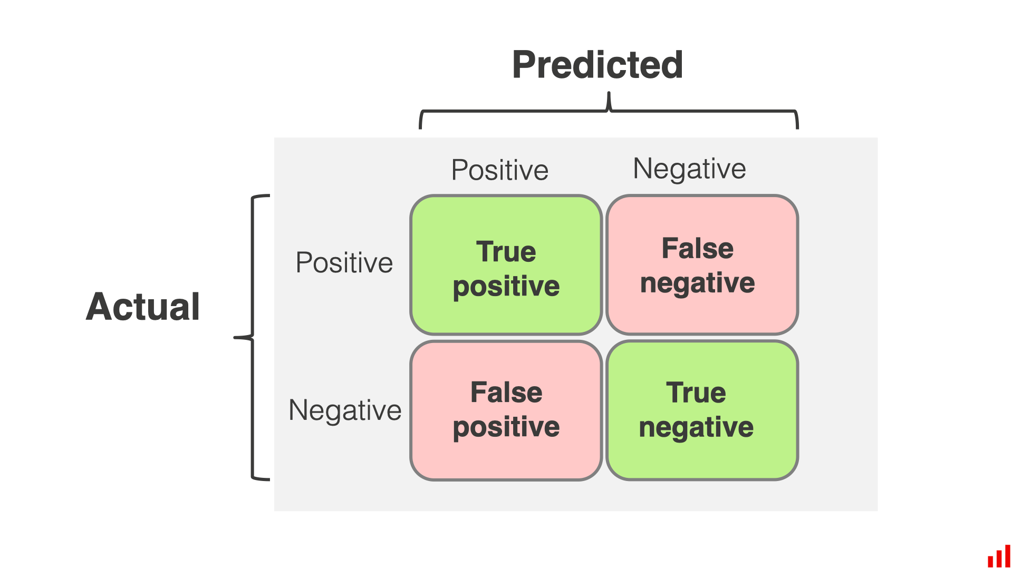
Classifcation metrics
1. Confusion Matrix

Slide 19


Classifcation metrics
2. Accuracy
Accuracy is the most intuitive and simple classification metric. It measures the percentage of correctly predicted instances out of all instances.
Imagine you have 100 predictions
80 are correct (either TP or TN)
20 are incorrect (either FP or FN)
Your accuracy would be

Slide 20
Classifcation metrics
2. Accuracy
Key Note
Accuracy is a good metric when the data is balanced, meaning there are roughly equal numbers of positive and negative examples.
However, for imbalanced datasets, accuracy can be misleading because the model could simply predict the majority class and achieve high accuracy.

Slide 21


Classifcation metrics
3. Precision
Precision is the ratio of correctly predicted positive observations to the total predicted positives. It tells us how many of the predicted positives are actually correct.
If your model predicts 30 positives, and 25 of them are actually correct (TP), while 5 are incorrect (FP), the precision would be :

Slide 22
Classifcation metrics
3. Precision
Key Insight
Precision is important in situations where false positives are costly, such as in email spam classification (false spam predictions are problematic).

Slide 23


Classifcation metrics
4. Recall (Sensitivity or True Positive Rate)
Recall measures the proportion of actual positives that were correctly identified. It answers the question: Of all the actual positives, how many did we correctly identify?
If there are 50 actual positives, and your model correctly predicted 40 of them, but missed 10, your recall would be:

Slide 24
Classifcation metrics
4. Recall (Sensitivity or True Positive Rate)
Key Insight
Recall is crucial in situations where false negatives are costly, such as disease detection. Missing a positive case (false negative) is more harmful than incorrectly predicting one.

Slide 25


Classifcation metrics
5. F1-Score
The F1-score combines precision and recall into one metric by calculating the harmonic mean of both. It’s particularly useful when you want to balance both precision and recall.
If your model has a precision of 80% and a recall of 70%, the F1-score would be

Slide 26
Classifcation metrics
5. F1-Score
Key Insight
The F1-score is a great metric when you need a balance between precision and recall. It’s especially useful in imbalanced datasets where accuracy can be misleading.

Slide 27

Classifcation metrics
6. ROC Curve and AUC (Area Under the Curve)
The Receiver Operating Characteristic (ROC) curve is a graphical representation that shows the performance of a binary classifier as the discrimination threshold is varied.
The ROC curve plots the TPR against the FPR at different threshold levels. The closer the curve is to the top-left corner, the better the model.

Slide 28
Classifcation metrics
6. ROC Curve and AUC (Area Under the Curve)
AUC (Area Under the Curve)
The AUC value represents the degree of separability. Higher AUC means the model is better at distinguishing between positive and negative classes.
AUC ranges from 0 to 1
1 = Perfect classifier
0.5 = Random guess
0 = Completely wrong classification

Slide 29
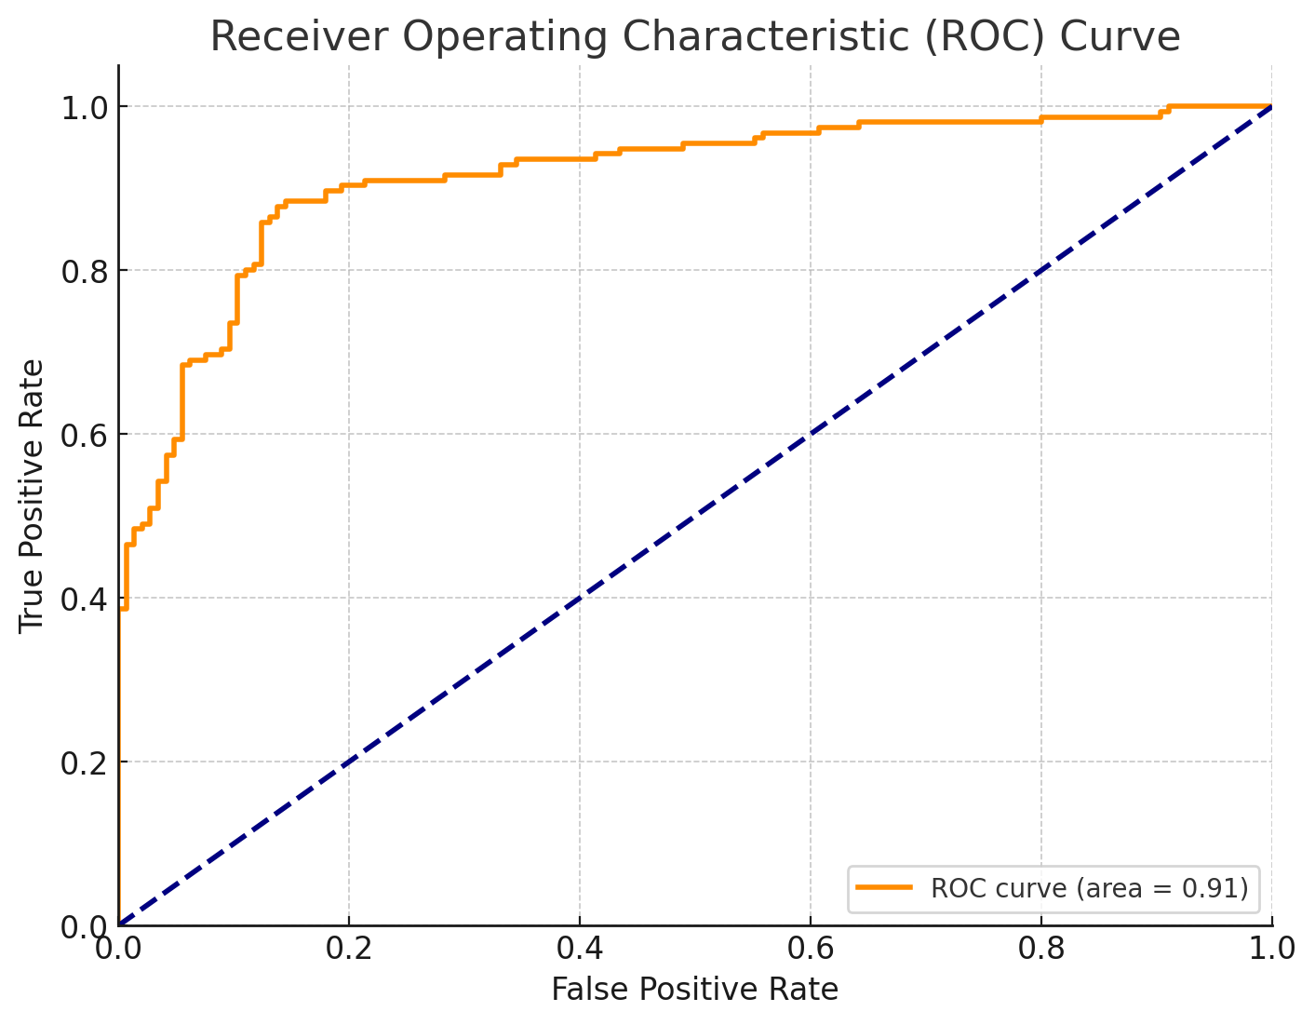
Classifcation metrics
AUC (Area Under the Curve)
ROC Curve is used to evaluate a classification model's performance.
It plots True Positive Rate (TPR) against False Positive Rate (FPR) at different thresholds.
The diagonal line represents random guessing.
The orange line shows the model's performance with an AUC of 0.91, indicating strong performance.
The closer the curve is to the top left corner, the better the model distinguishes between classes.

Slide 30
Classifcation metrics
6. ROC Curve and AUC (Area Under the Curve)
Key Insight
ROC-AUC is ideal when you care about the ranking of predictions rather than the exact predicted class.
It helps to understand how well the model distinguishes between classes across all thresholds.

Slide 31

Quiz
Why is Logistic Regression preferred for binary classification problems over Linear Regression?

Slide 32
Quiz
Expected Answer
Logistic Regression is specifically designed for binary classification problems, as it outputs probabilities that range between 0 and 1 using a sigmoid function. The decision boundary (threshold) is then set (commonly at 0.5) to classify the outputs into one of two classes.
Linear Regression, on the other hand, predicts continuous numeric values. When used for binary classification, it can produce values that go beyond the [0, 1] interval, which cannot be directly interpreted as probabilities. This makes it less suitable and less reliable for binary classification tasks.

